Slide 1

Group 3
Elliot Chester, Adam Speers, Matt Fisher, Lenneth Dayaon

Slide 2

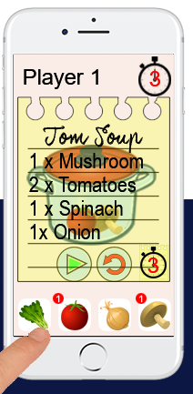
Our Game
2D Cooking Game
Symmetrical
Turn Based Competitive
Cognitive Memory Gameplay
Notes:
This will include our prototype and just a few words to describe it

Slide 3

How We Changed the game based on feedBack
It was too easy
Player 2 couldn’t read the recipes
It wasn’t clear who was winning
Notes:
Feedback from play testers, what to add, what to take away

Slide 4
How We Changed the game based on feedBack
Its too easy
We added a red herring
Player 2 can’t read the recipe
It’s not clear who’s winning
Notes:
Feedback from play testers, what to add, what to take away

Slide 5
How We Changed the game based on feedBack
Its too easy
We added a red herring
Player 2 can’t read the recipe
We flipped the recipe card for player 2
It’s not clear who’s winning
Notes:
Feedback from play testers, what to add, what to take away

Slide 6
How We Changed the game based on feedBack
Its too easy
We added a red herring
Player 2 can’t read the recipe
We flipped the recipe card for player 2
It’s not clear who’s winning
Each player now has a couple to make happy
Notes:
Feedback from play testers, what to add, what to take away

Slide 7
Current FeedBack
Its too easy
Player 2 can’t read the recipe
It’s not clear who’s winning
Notes:
Feedback from play testers, what to add, what to take away

Slide 8
Current FeedBack
Its too easy
Player 2 can’t read the recipe
It’s not clear who’s winning
Notes:
Feedback from play testers, what to add, what to take away

Slide 9
Current FeedBack
Its too easy
We added a red herring
Player 2 can’t read the recipe
It’s not clear who’s winning
Notes:
Feedback from play testers, what to add, what to take away

Slide 10
Current FeedBack
Its too easy
We added a red herring
Player 2 can’t read the recipe
We flipped the recipe card for player 2
It’s not clear who’s winning
Notes:
Feedback from play testers, what to add, what to take away

Slide 11
Current FeedBack
Its too easy
We added a red herring
Player 2 can’t read the recipe
We flipped the recipe card for player 2
It’s not clear who’s winning
Each player now has a couple to make happy
Notes:
Feedback from play testers, what to add, what to take away

Slide 12
What still needs to be done
Results screen to be finished
Couple screens need to be added in
Polish!
Notes:
Feedback from play testers, what to add, what to take away

Slide 13
Any Questions?

